Slide 1
Deep learning with the OpenCV DNN module
Bekenova Aruzhan Buranovna

Slide 2
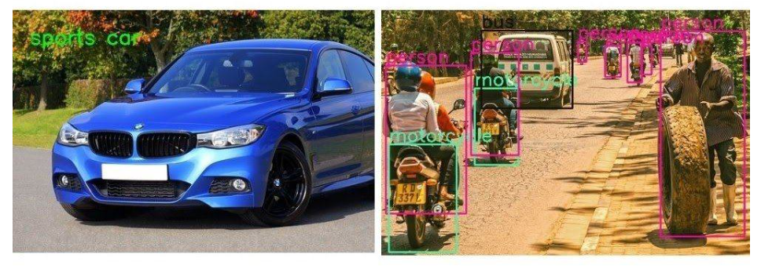
What is the OpenCV DNN module?
We all know OpenCV as one of the best computer vision libraries. The best part is the support for loading different models from different frameworks, with which we can perform several deep learning functions.
Deep Learning with OpenCV DNN 1000×800 module

Slide 3
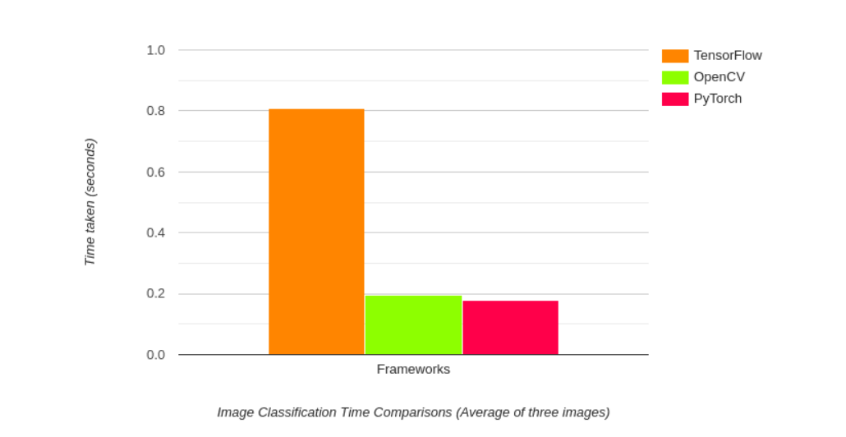
Why choose the OpenCV DNN module?
One of the best features of the OpenCV DN module is its high optimization for Intel processors. We can get good FPS when performing real-time video output for object detection and image segmentation applications. For example, let's look at the output speed of image classification for various frameworks.
Comparison of the output speed of image classification on the CPU for different frameworks.

Slide 4
Various deep learning functions supported by the OpenCV DNN module
The following list will give us a pretty good idea of the functions.
Classification of images.
Object detection.
Image segmentation.
Text detection and recognition.
Assessment of the pose.
Depth assessment.
Verification and recognition of identity and face.
The Reed persona.

Slide 5
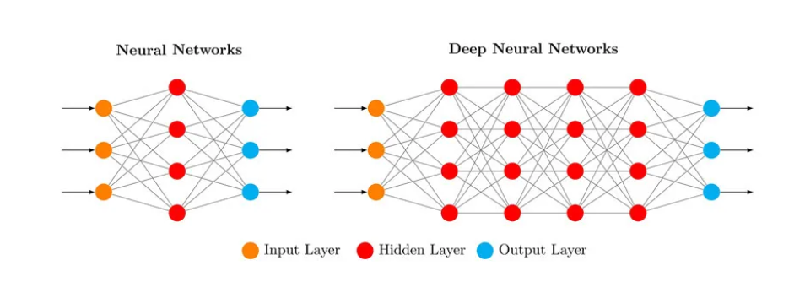
DNN — deep network
"Deep" in deep networks refers to the presence of multiple hidden layers that allow the network to learn complex representations from the input data. These hidden layers allow DNN to solve complex MO tasks that more "superficial" artificial networks cannot handle.

Slide 6
How deep neural networks work?
The input layer receives the raw data. Each node in this layer represents a feature or attribute of the input data.
Hidden layers. DNNs have two or more hidden layers sandwiched between the input and output layers. Each hidden layer consists of several neurons that are connected to neurons in both adjacent layers.
The output layer. The output layer provides the final predictions of the network. The number of neurons in the output layer depends on what tasks the network performs.

Slide 7
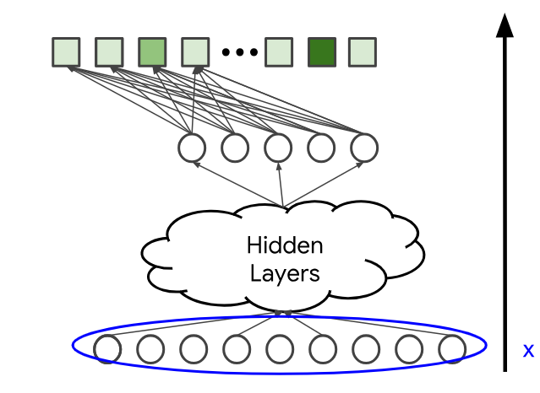
Unlike the matrix factorization approach, you can add additional characteristics such as age or country. Let's denote the input vector by x.

Slide 8

Data requirements
One of the primary requirements for deep learning is data. Data is the most critical component in constructing a highly accurate model. In several cases, deep neural networks typically require large amounts of data in order to prevent overfitting and perform well. The data requirements for object detection tasks might require more data for a model to detect different objects with high accuracy.
While data augmentation techniques are useful as a quick fix to some of these issues, data requirements are a must to consider for every deep learning project.

Slide 9
Final Thoughts
Deep neural networks are a fantastic resource for accomplishing most of the common artificial intelligence applications and projects. They enable us to solve image processing and natural language processing tasks with high accuracy.
It is significant for all skilled developers to stay updated with the emerging trends as a model that is popular today may not be as popular or the best choice in the upcoming future.

